Slide 1

CSE 301 Random Variables
Atif Hasan Rahman
CSE, BUET

Slide 2
Jointly Distributed Random Variables
We are often interested in probability statements concerning two or more random variables
For any two random variables X and Y, the joint cumulative probability distribution function of X and Y by

Slide 3
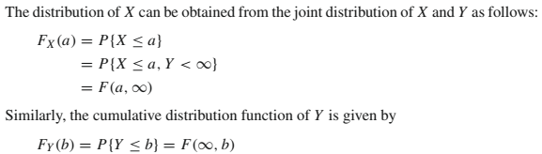
Jointly Distributed Random Variables

Slide 4
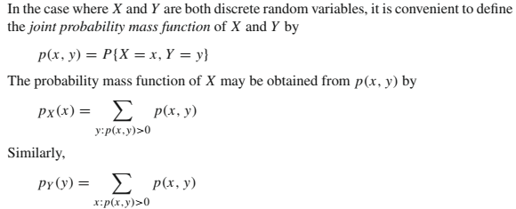
Jointly Distributed Random Variables

Slide 5
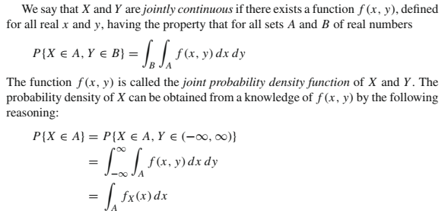

Jointly Distributed Random Variables

Slide 6
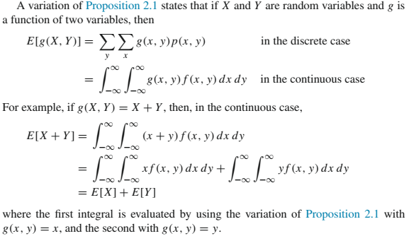
Jointly Distributed Random Variables

Slide 7
Jointly Distributed Random Variables
The same result holds in the discrete case and, combined with the corollary in Section 2.4.3, yields that for any constants a, b
Joint probability distributions may also be defined for n random variables. The corresponding result to the above equation states that if X₁, X₂, . . . , X_{n} are n random variables, then for any n constants a₁, a₂, . . . , a_{n},

Slide 8
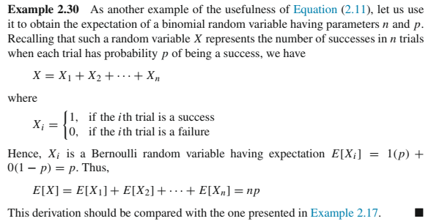
Jointly Distributed Random Variables

Slide 9
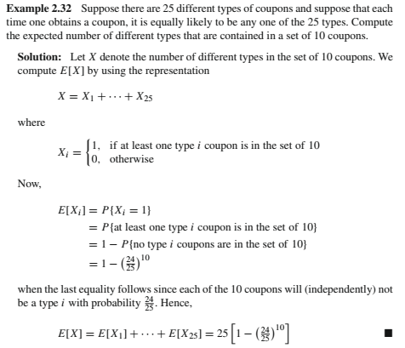
Jointly Distributed Random Variables

Slide 10

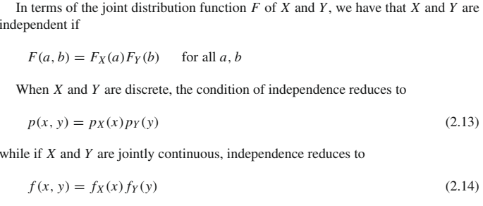
Independent Random Variables

Slide 11
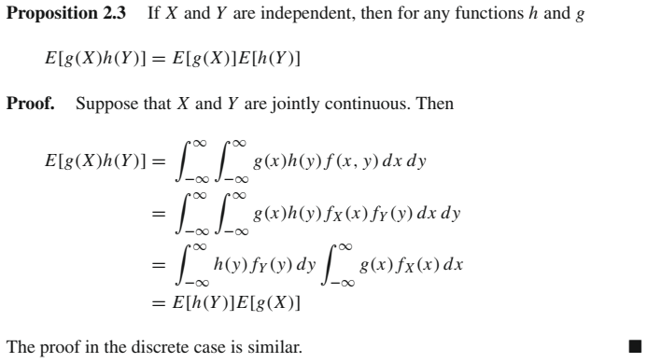
Independent Random Variables

Slide 12
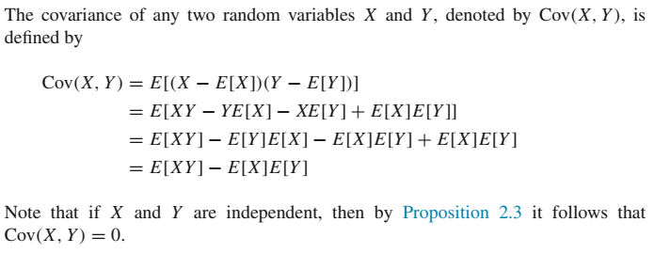
Covariance of Random Variables

Slide 13
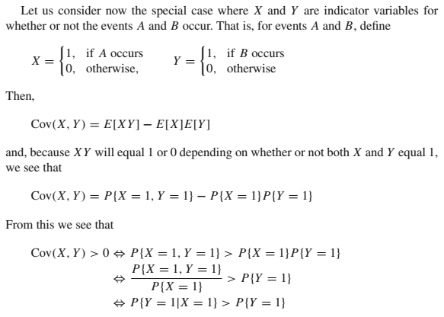
Covariance of Random Variables

Slide 14
Covariance of Random Variables
That is, the covariance of X and Y is positive if the outcome X = 1 makes it more likely that Y = 1
In general it can be shown that a positive value of Cov(X, Y) is an indication that Y tends to increase as X does, whereas a negative value indicates that Y tends to decrease as X increases

Slide 15

Properties of Covariance
For any random variables X, Y, Z and constant c,
Cov(X, X) = Var(X)
Cov(X, Y) = Cov(Y, X)
Cov(cX, Y ) = c Cov(X, Y )
Cov(X, Y + Z) = Cov(X, Y ) + Cov(X, Z)

Slide 16
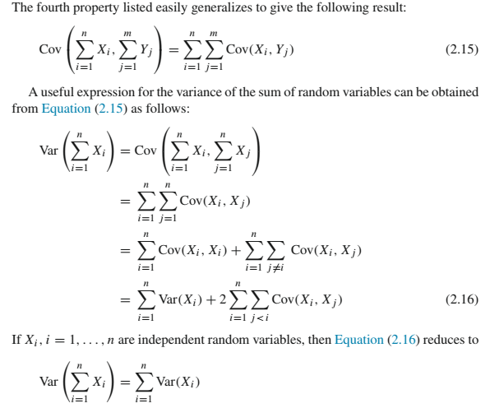
Properties of Variance and Covariance

Slide 17
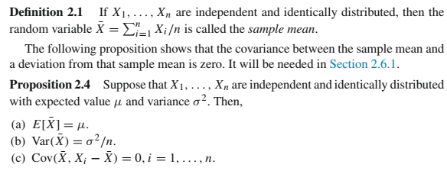
Properties of Variance and Covariance

Slide 18
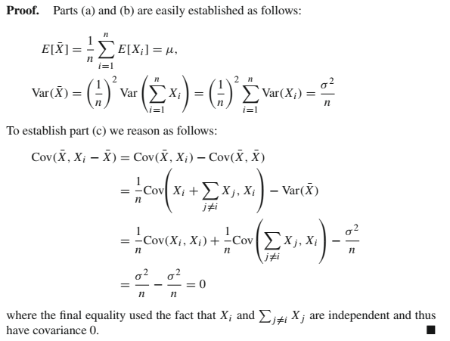
Properties of Variance and Covariance

Slide 19
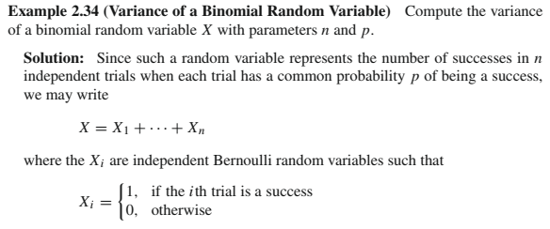
Properties of Variance and Covariance

Slide 20
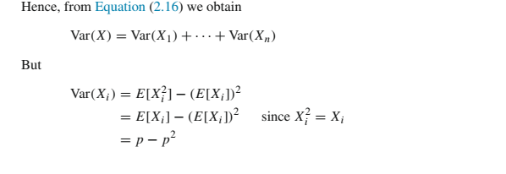

Properties of Variance and Covariance

Slide 21
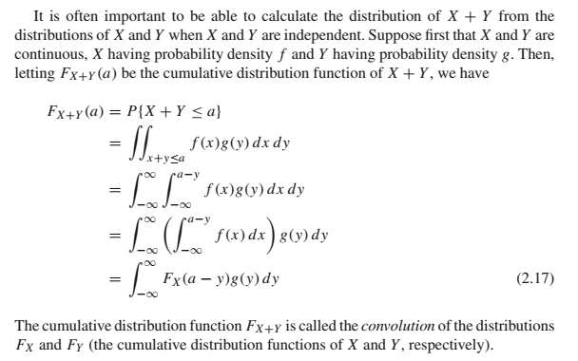
Convolution

Slide 22
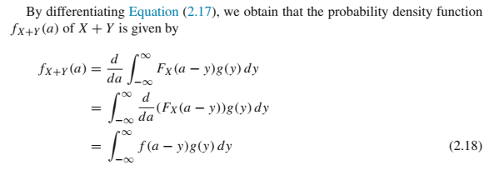
Convolution

Slide 23


Convolution

Slide 24
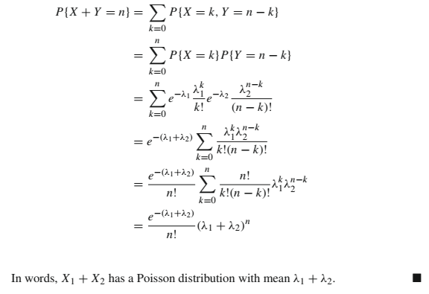
Convolution

Slide 25
Generating Functions
https://www.youtube.com/watch?v=YB7qnuo-GRY

Slide 26
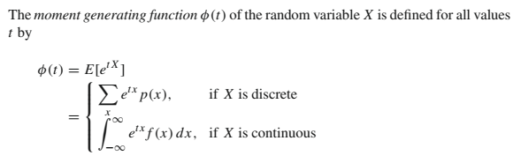
Moment Generating Functions

Slide 27
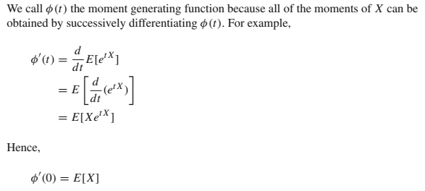
Moment Generating Functions

Slide 28
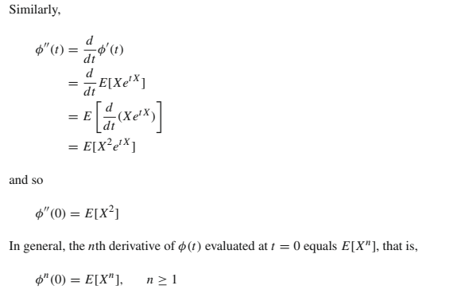
Moment Generating Functions

Slide 29
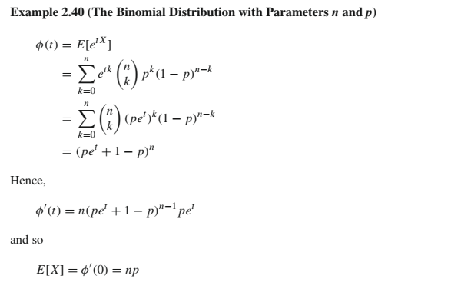
Moment Generating Functions

Slide 30
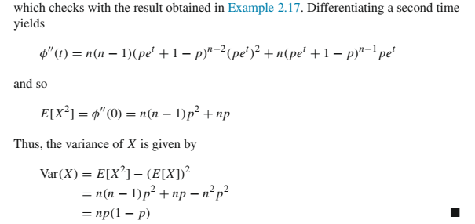
Moment Generating Functions

Slide 31
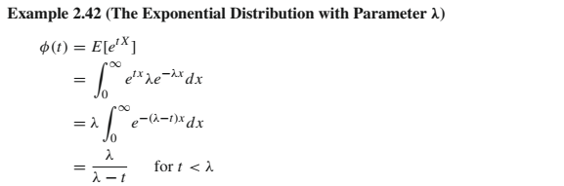
Moment Generating Functions

Slide 32
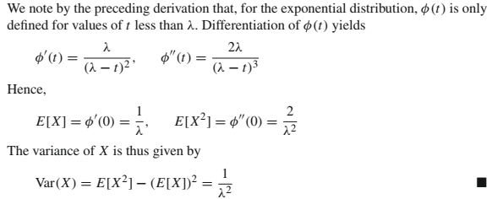
Moment Generating Functions

Slide 33
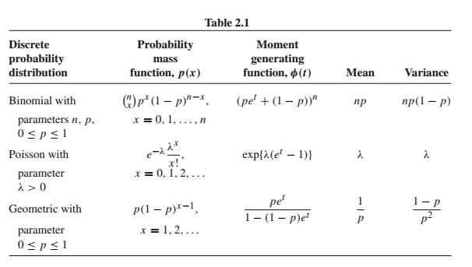
Moment Generating Functions

Slide 34
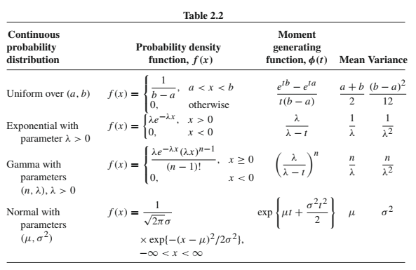
Moment Generating Functions

Slide 35
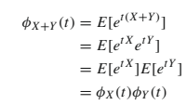
Moment Generating Functions
An important property of moment generating functions is that
the moment generating function of the sum of independent random variables is just the product of the individual moment generating functions
Suppose that X and Y are independent and have moment generating functions φ_{X}(t) and φ_{Y}(t), respectively.
Then φ_{X+Y}(t), the moment generating function of X + Y , is given by

Slide 36
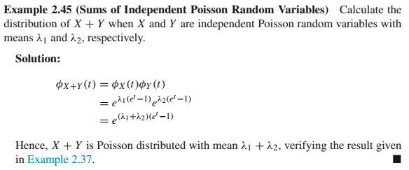
Moment Generating Functions

Slide 37
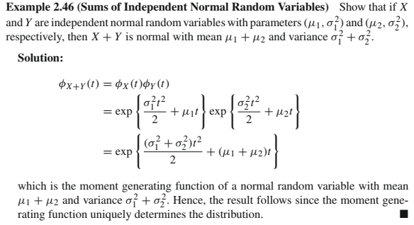
Moment Generating Functions

Slide 38

Poisson Paradigm
The number of successes that occur in n independent trials, each with success probability p is, when n is large and p small, approximately a Poisson random variable with parameter λ = np
It is not necessary that the trials have the same success probability, only that all the success probabilities are small
Suppose that the trials are independent, with trial i resulting in a success with probability p_{i}, where all the p_{i} are small.
Letting X_{i} equal 1 if trial i is a success, and 0 otherwise, it follows that the number of successes, call it X, can be expressed as

Slide 39

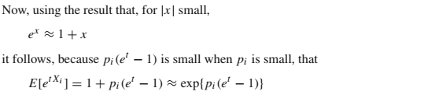
Poisson Paradigm

Slide 40
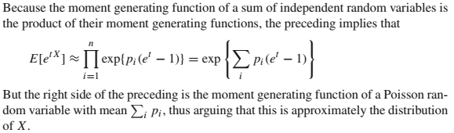
Poisson Paradigm

Slide 41

Poisson Paradigm
Not only is it not necessary for the trials to have the same success probability for the number of successes to approximately have a Poisson distribution, they need not even be independent, provided that their dependence is weak
Whereas the trials are not independent, their dependence appears, for large n, to be weak
The statement that “the number of successes in n trials that are either independent or at most weakly dependent is, when the trial success probabilities are all small, approximately a Poisson random variable” is known as the Poisson paradigm

Slide 42

Moment Generating Functions and Laplace Transform
For a nonnegative random variable X, it is often convenient to define its Laplace transform g(t), t ≥ 0, by
That is, the Laplace transform evaluated at t is just the moment generating function evaluated at -t.

Slide 43
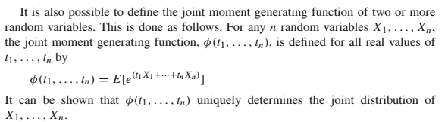
Joint Moment Generating Function

Slide 44
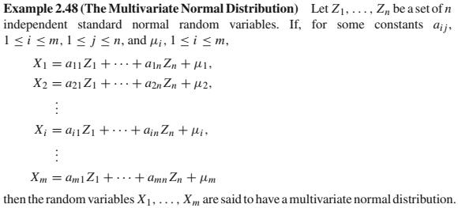
Multivariate Normal Distribution

Slide 45
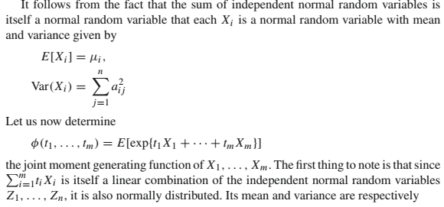
Multivariate Normal Distribution

Slide 46
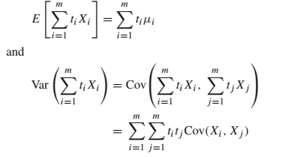
Multivariate Normal Distribution

Slide 47
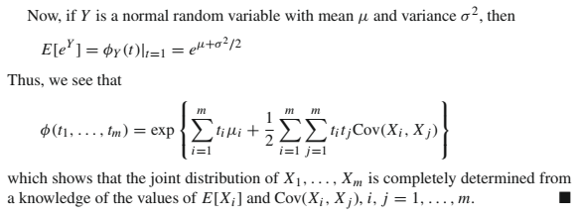
Multivariate Normal Distribution

Slide 48


Sample Variance
Suppose, we are sampling from a population and want to estimate the population variance σ²
Let X₁, . . . , X_{n} be independent and identically distributed random variables, each with mean μ and variance σ². The random variable S² defined by
is called the sample variance of these data

Slide 49

Chi-squared Random Variable

Slide 50
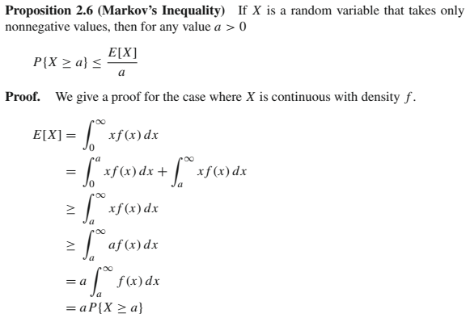
Markov’s Inequality

Slide 51
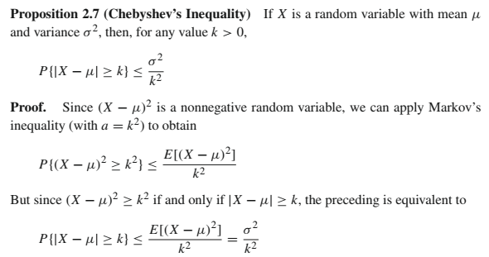
Chebyshev’s Inequality

Slide 52
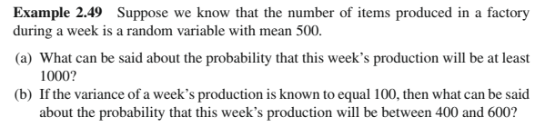
Inequalities

Slide 53
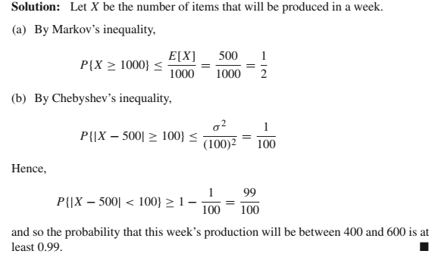
Inequalities

Slide 54
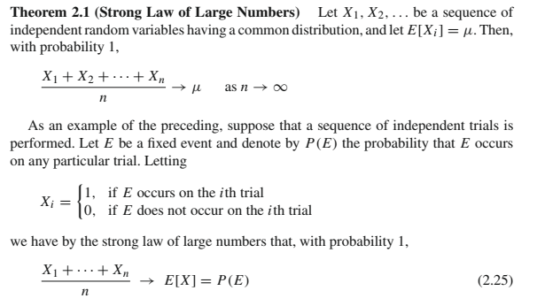
Strong Law of Large Numbers

Slide 55
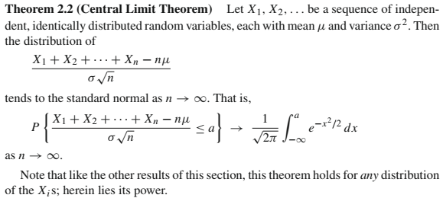
Central Limit Theorem

Slide 56
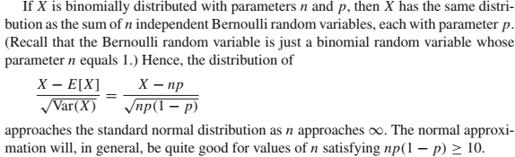
Central Limit Theorem

Slide 57
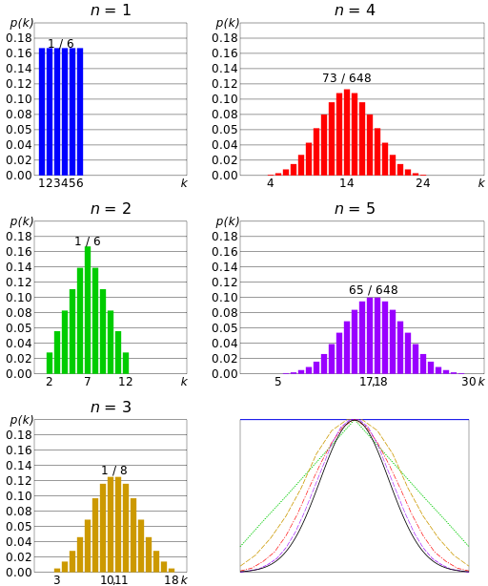
Central Limit Theorem

Slide 58
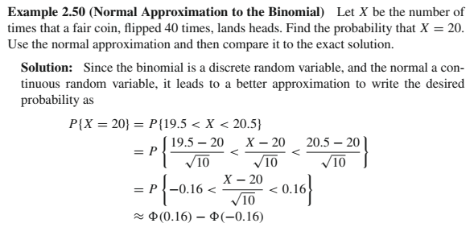
Central Limit Theorem

Slide 59
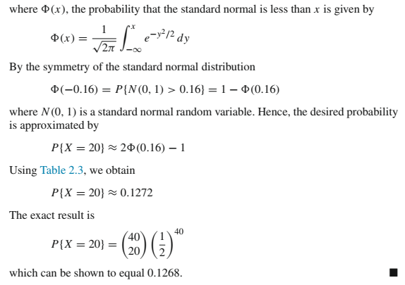
Central Limit Theorem

Slide 60

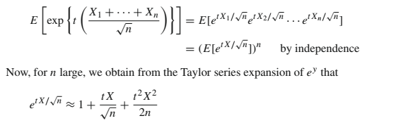
Central Limit Theorem

Slide 61
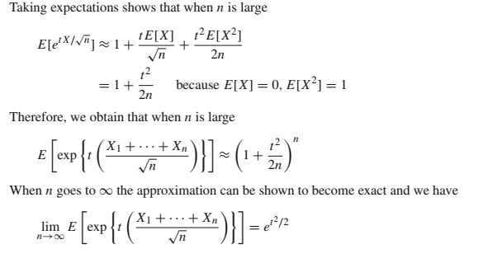
Central Limit Theorem

Slide 62
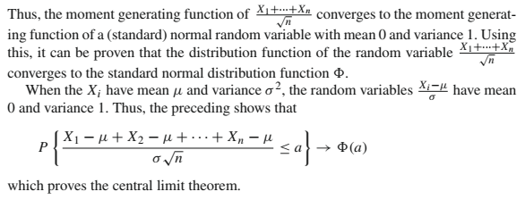
Central Limit Theorem

